Slide 1
Baltimore and Dallas: Social Mobility evaluated based on Career Opportunities, Density of Jobs, and Individual Income Durdona Gaibova

Slide 2
Goal: Compare social mobility of Dallas and Baltimore Using following variables:
Job density
Average job growth
Individual Income
Our goal is to perform a comparison of the two cities to see how similar or dissimilar they are.

Slide 4
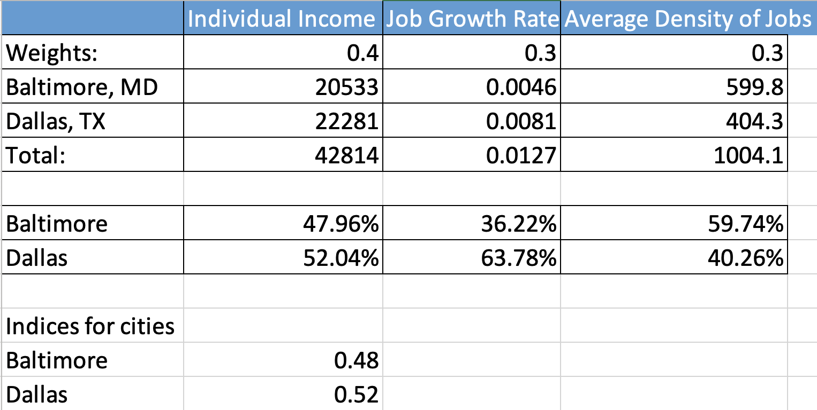
Measuring social Mobility index weighting previous criteria:

Slide 5
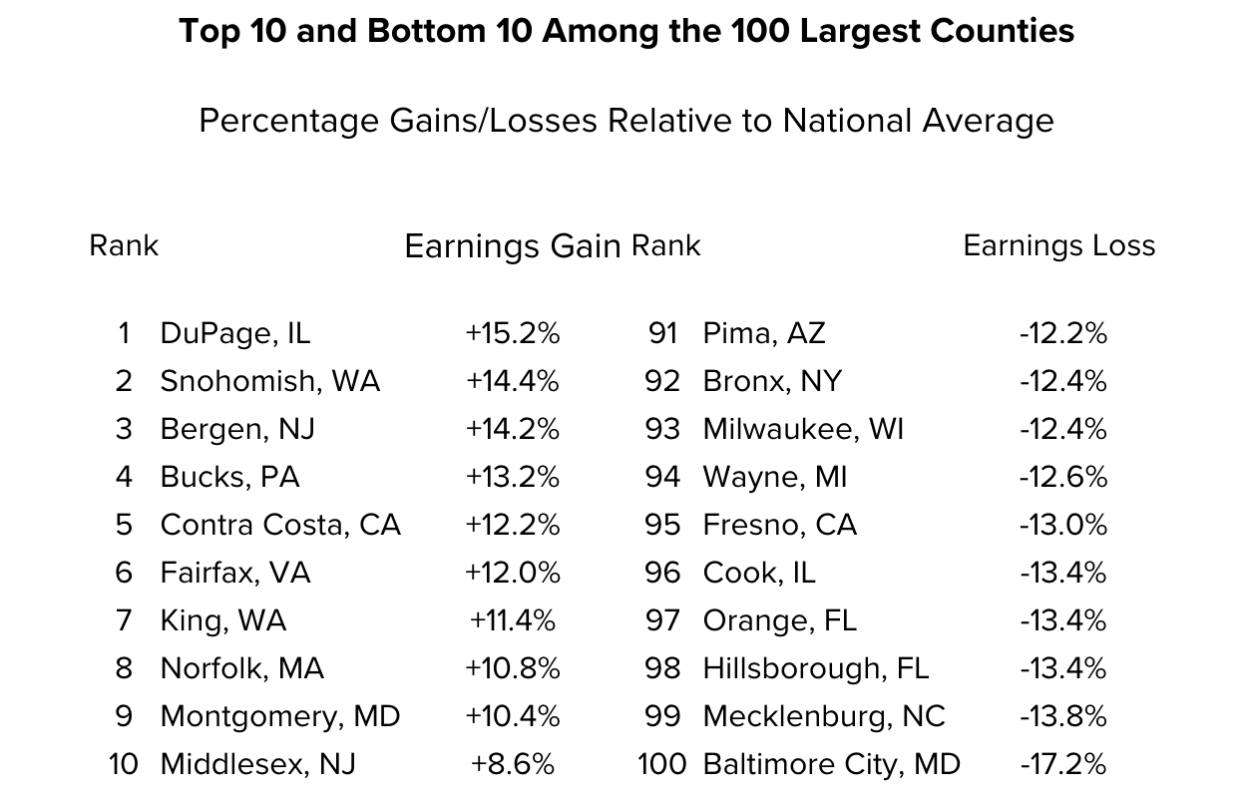
Comparing our index to opportunity insights’ index:
Factors associated with strong upward mobility from Opportunity Insights:
less segregation by income and race;
lower levels of income inequality;
better schools;
lower rates of violent crime; and
a larger share of two-parent households.
Factors associated with strong social mobility from Our Findings:
Job density rate in the area;
Individual Income;
Average Job growth /rates

